Slide 1
Project Work :
UE15CS490(Major)/UE15CS492(Minor)
Final ISA(Review 5) / ESA 2019
Project Title : Linguistic Analysis of Indo-European Languages
Project ID : PW19SMP003
Project Guide : Prof. Shreekanth M Prabhu
Project Team : Roshan U[01FB15ECS246],
Sanath Bhimsen[01FB15ECS260],
Mukesh M Karanth[01FB15ECS361].

Slide 2
Problem Statement
We thought that the current model of Indo-European language evolution theory might be a biased model due to the limited considerations and the restricted visualisation of the languages.
Therefore, We want to include possibilities of word transfers and mutual growth, resulting in the growth of both the languages involved.
After using these ideas and considerations, we want to come up with a better, more realistic visualization of the Indo-European Languages, one that may resemble an network with various links and crosslinks that connect languages that were thought to have developed independently.

Slide 3
Literature Survey
[1] Renfrew, Colin. "The Origins of Indo-European Languages." Scientific American 261, no. 4 (1989): 106-15.
http://www.jstor.org/stable/24987446.
[2] Boc, Alix, Anna Maria Di Sciullo, and Vladimir Makarenkov. "Classification of the Indo-European
languages using a phylogenetic network approach." In Classification as a Tool for Research, pp. 647-655.
Springer, Berlin, Heidelberg, 2010.
[3] Prabhu, Shreekanth. (2018). Evolving a Framework to interpret the Vedas. 10.13140/RG.2.2.32939.95529.

Slide 4
[4]. Clustering Semantically Equivalent Words into Cognate Sets in Multilingual Lists
http://www.aclweb.org/anthology/I11-1097
[5]. Mapping the Origins and Expansion of the Indo-European Language Family Remco
Bouckaert, Philippe Lemey, Science 24 Aug 2012:Vol. 337, Issue 6097, pp. 957-960
DOI: 10.1126/science.1219669
[6]. The Origins of Indo-European Languages Colin Renfrew Scientific American Vol. 261,
No. 4 (OCTOBER 1989), pp. 106-115
Dept.

Slide 5
Proposed Solution
○ Collect the dataset of Indo-European languages from Langfocus website and
other similar websites.
○ Select a few key languages and pre-process the dataset for any discrepancies.
○ Perform analysis on the dataset, by getting distance between languages by the closeness of their words using distance measures like Levenshtein distance, etc. and centrality measures.

Slide 6
○ Understand and apply Horizontal Gene Transfer Detection Algorithm.
○ Combine all the results and visualise the dataset to obtain a new and better
model of the layout of Indo-European Languages.

Slide 7
Why Your Solution is Better?
Features of the solution
Consideration of other possibilities like Mutual growth and word sharing.
Adapting a new and unique approach of dynamic dataset building that takes synonyms of the word closest to the transliterated words.
Visualization in the form of a network to depict linkages between independent languages.

Slide 8
Technologies / Methodologies
TECHNOLOGIES:
-> Applications:
-Google Translate API: Used to retrieve transliterated words quickly and in bulk.
-Jupyter Notebook: For its GUI and ease of use.
-Rstudio: consolidated representation of results, command prompt and single shot execution of programs.
-NodeXL: It provides an easy to use GUI with simple drag & drop options and a multitude of similarity measures at the click of a button, excellent for visualization.

Slide 9
-> Languages:
- Python: Used because of its ease of programing and amazing libraries that provide wide range of functionality in analytics.
- R : Used for visualisation because of its packages that aid good visualisation and its simplicity.

Slide 10
Dependencies and Risks
DEPENDENCIES:
-> The usage is strictly limited only to study the effects and results of social network analysis on Linguistics and its representations.
-> The project requires packages which are good for visualization purposes and have good functionality for Network Analysis.
ASSUMPTIONS:
->A single language was taken from each of the lineages of the Indo-European Language, Proto-Indo-European.
->The number of words chosen to represent each language were all transliterated in English.
-> The maximum number of words in a single language is restricted to 200.

Slide 11
RISKS:
-> The limited number of centrality and similarity measures used for analysis could potentially affect the accuracy of the visualisation.
-> The limited pool of words chosen might not be sufficient enough to convey any good results.
-> The words chosen might not be the best choice to best depict all languages perfectly.

Slide 12
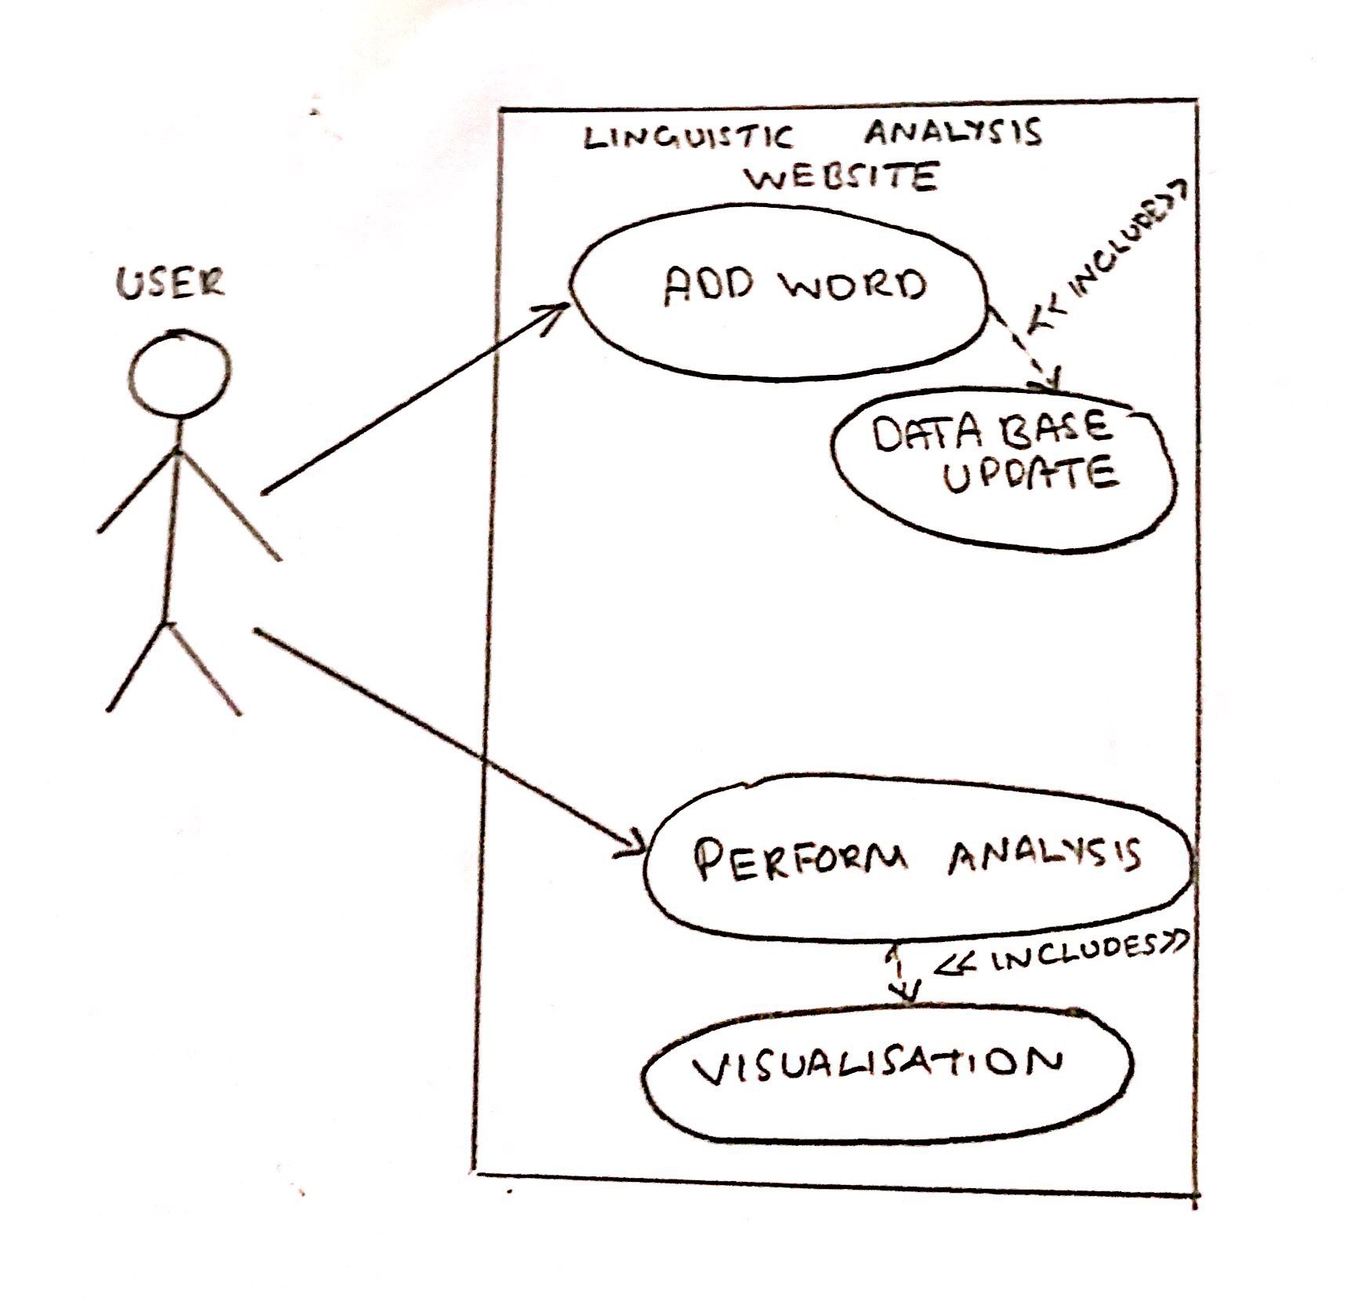
UI/ Use Case
USE CASE DIAGRAM

Slide 13
Modules
1) Collections of English Words : In this module, We started off by collecting around 1000 English words and then filtered it down to 300 words suitable words for our study. We made sure that the data had a good number of stop words, nouns, proverbs,
adjectives and words representing relationships like Father, Mother, Etc.
2) Translation of English Words : Once this was done , The googletrans python API was used in order to translate each english words into the other Indo-European Languages we had chosen. They are German , Italian , French , Spanish , Hindi
,Russian, Latin and Sanskrit. Since there is no support for Sanskrit on Google Translate , We used an English to
Sanskrit Dictionary in order to find the Sanskrit Representation of the word.

Slide 14
3) Loading all these words into a dataframe : The dataset is prepared this way and it is stored in csv format columns represent the languages and we have the words and their representation on each row.
4) Preprocessing : Once the dataset was created, each word was replaced with its phonetic pronunciation using manual or automatic conversion wherever applicable. As the API might sometimes return the word in its native representation, this would negatively affect our results because the special characters present as a translation of certain words in other languages will not be considered close to a word even if it sounds the same when pronounced, this is because of the way the similarity measure is computed.
5) Weighted Similarity Graph Using NetworkX : The python library networkX was used to prepare a visualization that shows how close every pair of languages are. We used weighted edges for the same. In this module, each word of every language taken for the study for a particular meaning will be taken and compared with each other and their similarity score will be computed for every possible pair and the result will be stored and returned as a matrix.

Slide 15
6) Creation of Distance Matrix : For every english word we construct distance matrix showing the distance between that word and its representation in all other languages.
Since we have nine languages in total we will create a 9x9 matrix that stores the
distance matrix for all language’s words for a particular meaning. This will be used
for the detection of clusters, communities and hidden linkages between the words
from different languages. This will give us a basic idea of the potential relationship
that might exist between two previously independent languages.
7) Cognate Cluster Creation : The distance matrix for each word is passed to the lingpy cognate cluster creation method and it returns a dictionary. The keys of the dictionary represent the cluster number and the value is a list which contains the word that falls in that cluster. These results are stored in a csv file and passed as an input for the visualization modules.

Slide 16
8) Network Nodes Creation : The cognate clusters stored in the csv file are read into a dataframe variable in R and are converted into a format readable by the network node creator function. That is, the cluster number and the fused attribute of word and language are passed as the two parameters for the node creation function, the function then creates a base network layout of all the nodes.
9) Visualization in R : The network layout is then passed to the community detector which portrays the nodes as individually highlighted clusters of different colors, which give us a good idea of the hidden relationships that may potentially exist between two independent languages.

Slide 17
Design Approach
Design approach: Top-Down Approach
Benefits:
Decreased Risk: Since the approach is planned well in advance.
Good Organization: Tasks are determined and filtered down without any confusion because project goals are set and will not be affected by outside opinions.
Minimized Cost: Members are free to complete their own tasks unique to their role in the project and aren’t saddled with the responsibility of setting project-wide goals.
Drawbacks:
Limited Creativity: Members are engrossed in their responsibilities and are unable to contribute innovations/ideas to the project — sometimes leading to frustration and a lack of motivation to perform.
Slow Response to Challenges: When a challenge arises as a result of a decision, it can take time for the members to establish a solution because there are limited minds contributing to decisions.

Slide 18
Test Strategy
Testing Methodologies:
Data set:
- Check the words in the dataset against the words in the google grammar for the language to validate it’s existence.
- Compare the phonetically translated word against its actual phonetic pronunciation to cross check the valid translation.
- Check for alternate forms of the same word.
Code Output:
- Check the output for multiple data sets.
- Perform analysis on different types of words and compare the results.
- Visual Inspection of outputs to verify the code.
- Compare the visual tree with the online sources to validate output.
- Validate the outputs observed using domain knowledge.

Slide 19
Project Completion
Project Report Status – Ready
Page count: 55
Report type: research report
Project Demo – Fully done
complete in almost all respects
working of the project
Data set creation needs to be demoed

Slide 20
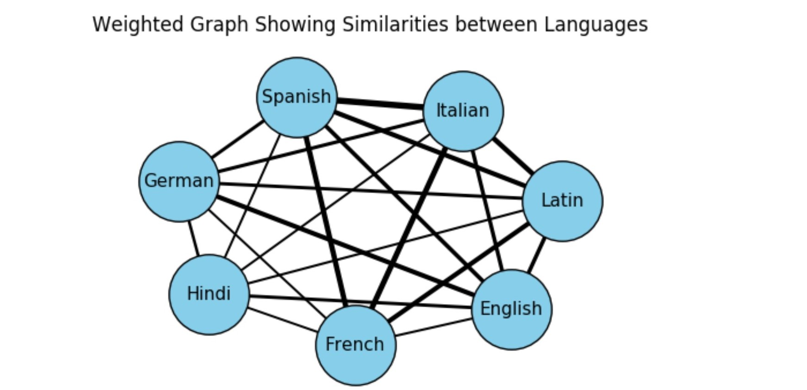
Project Results

Slide 21
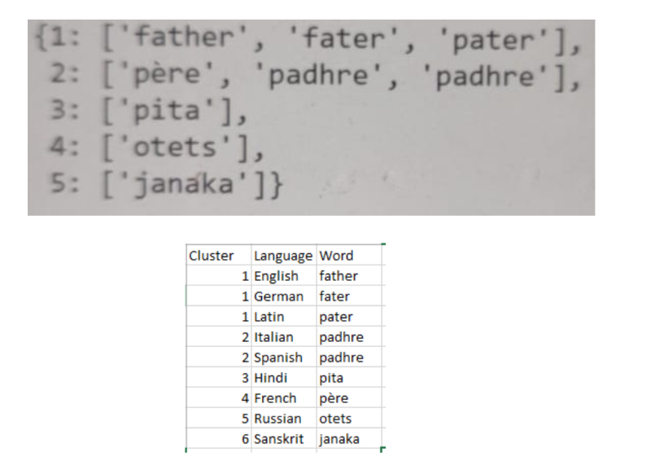

Slide 22
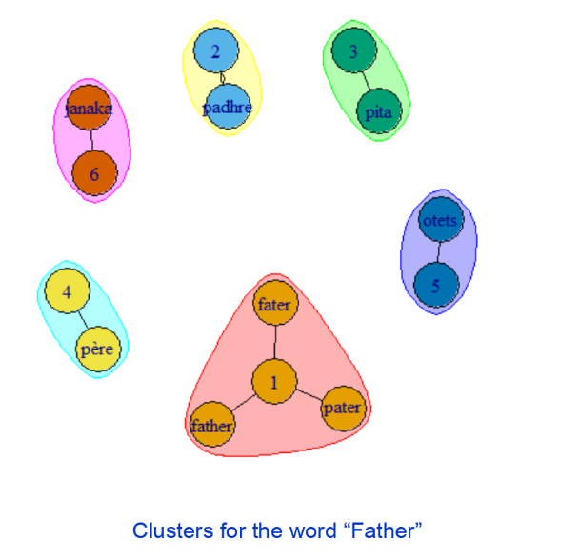

Slide 23
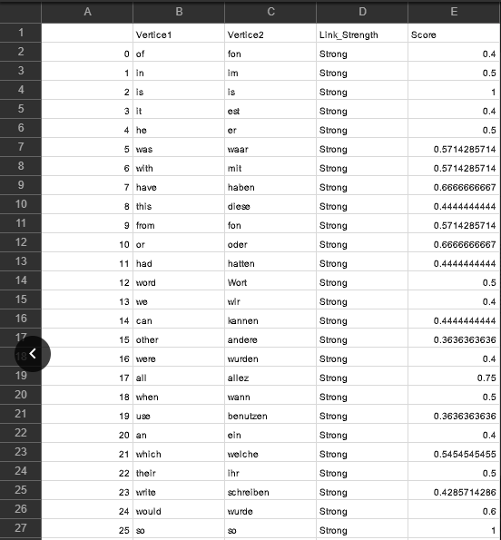

Slide 24
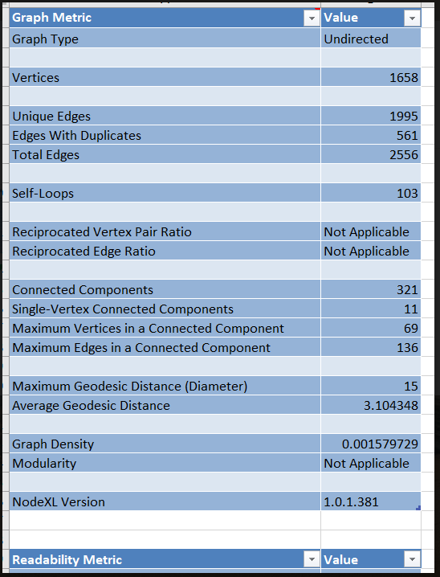

Slide 25
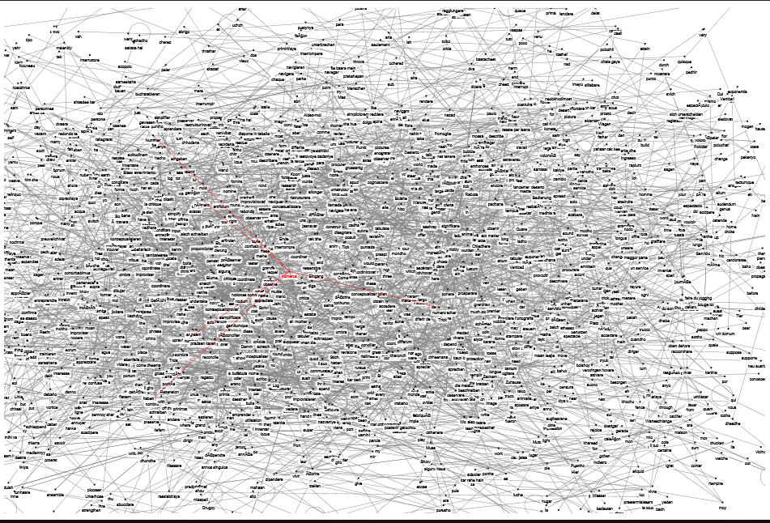

Slide 26
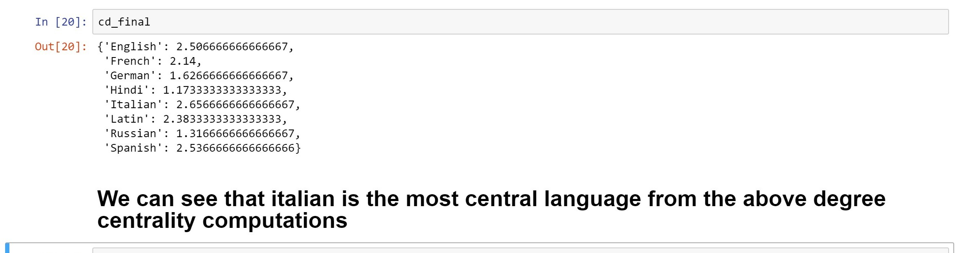

Slide 27
Planned Effort Vs Actual Effort
Planned Effort
Week Number | Project Phase | Responsibility
1 - 3 | Understanding and Research on project | All Members
3 | Dataset Collection | Roshan
4 - 6 | Similarity Computations and Cognate formation | Sanath
7 | Visualization | Mukesh
8 | Integration and Testing | All Members

Slide 28
Actual Effort
Role | Time taken | Responsibility
Research on project | 3 Weeks | All Members
Dataset Collection | 4 Weeks | Sanath
Data Pre-Processing | 3 Weeks | Roshan
Similarity & Cognates | 2 Weeks | Sanath, Mukesh
Visualization | 3 Weeks | NodeXL: Sanath, Roshan R : Mukesh
Documentation | 15 Weeks | Mukesh
Final Project Report | 1 Week | All Members

Slide 29
Lessons Learnt
This project has helped us in understanding the linguistic analysis domain, it has given us a better idea about the various challenges and methodologies that are involved in a successful attempt at linguistic analysis
In our attempt at performing Linguistic analysis on the Indo-European languages and their evolution and development theory, we have come across a new approach on expanding and building up a database from scratch which will give a better quality dataset to work on. This approach is more efficient and time saving because of its semi-automated nature.
Finally, we obtained new insights and visualizations that have helped us depict the Indo-European languages as a network like structure within which the languages have links between themselves which was not thought to have existed in the original tree like structure.

Slide 30
Further Plans for the Fututre
Improve the NodeXL visualization to filter the nodes further to get a clear idea of the underlying network structure.
Infer further details about the visualization like most commonly spread word, most central words in all languages, etc.
Improve the NodeXL visualization into R or Python and then colour code the nodes to understand the linkages between nodes better.

Slide 31
Thank You

